Slide 1

Standard Multithreading Support in C++
By: Chris DeVisser

Slide 2
The Importance of Multithreading
Modern processors have many cores, but often, only one is used in an application
Significantly speeds up long operations if done correctly
Increases application responsiveness
We're moving into a multithreaded world

Slide 3
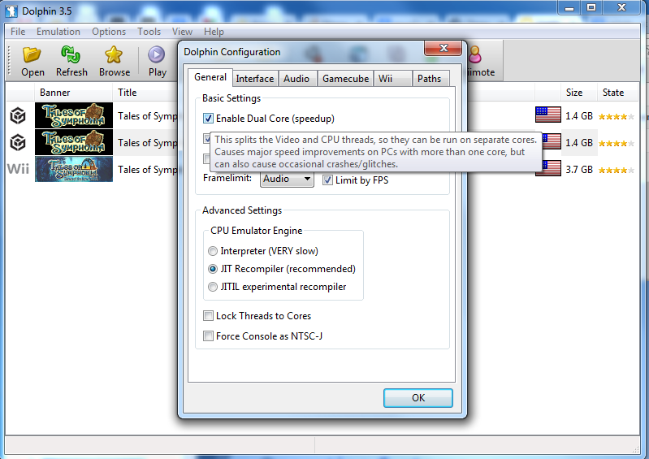
What Uses Multithreading?
Games
Number-crunching applications
Operating Systems
Most responsive applications

Slide 4
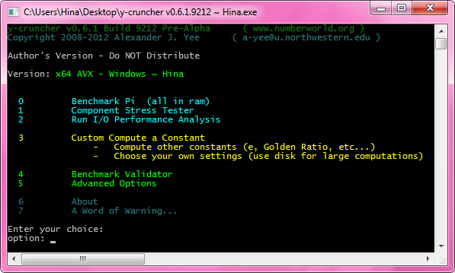
y-cruncher
Holds the record for most digits of pi calculated, with 10 trillion
Uses multithreading extensively

Slide 5

Windows 8
"Fast and Fluid" => new policy
All functions that could take longer than 50ms were made asynchronous
Apps stay responsive

Slide 6
C++ Concurrency
C++11 brought standardized concurrency
Launching another thread is easy:

Slide 7
C++ Concurrency
C++11 brought standardized concurrency
Launching another thread is easy:
#include <thread>
int main() { std::thread t([]{/*stuff*/});
t.join();
}

Slide 8
Launching Asynchronous Tasks
std::future holds a task's status

Slide 9
Launching Asynchronous Tasks
std::future holds a task's status
auto fut = std::async([]{/*stuff*/});
//concurrent
fut.wait();

Slide 10
Launching Asynchronous Tasks
std::future holds a task's status
auto fut = std::async([]{/*stuff*/});
//concurrent
fut.wait();
Be sure to assign the result of async, or the function may not launch a new thread

Slide 11
Preventing Half-Written Data
Two threads use the same variable

Slide 12
Preventing Half-Written Data
Two threads use the same variable
std::atomic<int> i;

Slide 13
Preventing Half-Written Data
Two threads use the same variable
std::atomic<int> i;
//thread 1
++i;

Slide 14
Preventing Half-Written Data
Two threads use the same variable
std::atomic<int> i;
//thread 1
++i;
//thread 2
std::cout << i;

Slide 15
Tip: Use RAII
Never forget to clean up again
Exception-safe

Slide 16
Tip: Use RAII
Never forget to clean up again
Exception-safe
int i = 0;
std::mutex m;

Slide 17
Tip: Use RAII
Never forget to clean up again
Exception-safe
int i = 0;
std::mutex m;
//threads
m.lock();
++i;
//oops, forgot to unlock

Slide 18
Tip: Use RAII
Never forget to clean up again
Exception-safe
int i = 0;
std::mutex m;
//threads
std::lock_guard<std::mutex> lock(m);
++i;
//m unlocked when lock goes out of scope

Slide 19
Managing Shared Resource Use
Two threads use the same resource

Slide 20
Managing Shared Resource Use
Two threads use the same resource
std::ofstream fout("out.txt");
std::mutex file;

Slide 21
Managing Shared Resource Use
Two threads use the same resource
std::ofstream fout("out.txt");
std::mutex file;
//thread 1
std::lock_guard<std::mutex> lock(file);
fout << "thread 1\n";

Slide 22
Managing Shared Resource Use
Two threads use the same resource
std::ofstream fout("out.txt");
std::mutex file;
//thread 1
std::lock_guard<std::mutex> lock(file);
fout << "thread 1\n";
//thread 2
std::lock_guard<std::mutex> lock(file);
fout << "thread 2\n";

Slide 23
Tip: Avoid Deadlocks
Occur when two threads wait on each other
}

Slide 24
Tip: Avoid Deadlocks
Occur when two threads wait on each other
//example adapted from http://pages.cs.wisc.edu/~remzi/Classes/537/Fall2005/Lectures/lecture8.pdf
int X = 0, Y = 0;
std::mutex x, y;

Slide 25
Tip: Avoid Deadlocks
Occur when two threads wait on each other
//example adapted from http://pages.cs.wisc.edu/~remzi/Classes/537/Fall2005/Lectures/lecture8.pdf
int X = 0, Y = 0;
std::mutex x, y;
//thread 1 //thread 2
std::lock_guard<std::mutex> lock(x); std::lock_guard<std::mutex> lock(y);
++X; --Y;

Slide 26
Tip: Avoid Deadlocks
Occur when two threads wait on each other
//example adapted from http://pages.cs.wisc.edu/~remzi/Classes/537/Fall2005/Lectures/lecture8.pdf
int X = 0, Y = 0;
std::mutex x, y;
//thread 1 //thread 2
std::lock_guard<std::mutex> lock(x); std::lock_guard<std::mutex> lock(y);
++X; --Y;
{ {
std::lock_guard<std::mutex> lock(y); std::lock_guard<std::mutex> lock(x);
++Y; --X;
} }

Slide 27
Tip: Avoid Deadlocks
Occur when two threads wait on each other
//example adapted from http://pages.cs.wisc.edu/~remzi/Classes/537/Fall2005/Lectures/lecture8.pdf
int X = 0, Y = 0;
std::mutex x, y;
//thread 1 //thread 2
std::lock_guard<std::mutex> lock(x); std::lock_guard<std::mutex> lock(y);
++X; --Y;
{ {
std::lock_guard<std::mutex> lock(y); std::lock_guard<std::mutex> lock(x);
++Y; --X;
} }

Slide 28
Tip: Avoid Deadlocks
//thread 1 //thread 2
std::lock_guard<std::mutex> lock(x); std::lock_guard<std::mutex> lock(y);
++X; --Y;
{ {
std::lock_guard<std::mutex> lock(y); std::lock_guard<std::mutex> lock(x);
++Y; --X;
} }

Slide 29
Tip: Avoid Deadlocks
//thread 1 //thread 2
std::lock_guard<std::mutex> lock(x); std::lock_guard<std::mutex> lock(y);
++X; --Y;
{ {
std::lock_guard<std::mutex> lock(y); std::lock_guard<std::mutex> lock(x);
++Y; --X;
} }
Imagine this scenario:

Slide 30
Tip: Avoid Deadlocks
//thread 1 //thread 2
std::lock_guard<std::mutex> lock(x); std::lock_guard<std::mutex> lock(y);
++X; --Y;
{ {
std::lock_guard<std::mutex> lock(y); std::lock_guard<std::mutex> lock(x);
++Y; --X;
} }
Imagine this scenario:
Thread 1 locks x

Slide 31
Tip: Avoid Deadlocks
//thread 1 //thread 2
std::lock_guard<std::mutex> lock(x); std::lock_guard<std::mutex> lock(y);
++X; --Y;
{ {
std::lock_guard<std::mutex> lock(y); std::lock_guard<std::mutex> lock(x);
++Y; --X;
} }
Imagine this scenario:
Thread 1 locks x
Thread 2 locks y

Slide 32
Tip: Avoid Deadlocks
//thread 1 //thread 2
std::lock_guard<std::mutex> lock(x); std::lock_guard<std::mutex> lock(y);
++X; --Y;
{ {
std::lock_guard<std::mutex> lock(y); std::lock_guard<std::mutex> lock(x);
++Y; --X;
} }
Imagine this scenario:
Thread 1 locks x
Thread 2 locks y
Thread 1 tries to lock y and waits

Slide 33
Tip: Avoid Deadlocks
//thread 1 //thread 2
std::lock_guard<std::mutex> lock(x); std::lock_guard<std::mutex> lock(y);
++X; --Y;
{ {
std::lock_guard<std::mutex> lock(y); std::lock_guard<std::mutex> lock(x);
++Y; --X;
} }
Imagine this scenario:
Thread 1 locks x
Thread 2 locks y
Thread 1 tries to lock y and waits
Thread 2 tries to lock x and waits

Slide 34
Tip: Avoid Deadlocks
//thread 1 //thread 2
std::lock_guard<std::mutex> lock(x); std::lock_guard<std::mutex> lock(y);
++X; --Y;
{ {
std::lock_guard<std::mutex> lock(y); std::lock_guard<std::mutex> lock(x);
++Y; --X;
} }
Imagine this scenario:
Thread 1 locks x
Thread 2 locks y
Thread 1 tries to lock y and waits
Thread 2 tries to lock x and waits
Deadlock!

Slide 35
Tip: Avoid Deadlocks
One solution: lock both
int X = 0, Y = 0;
std::mutex both;
//thread 1 //thread 2
std::lock_guard<std::mutex> lock(both); std::lock_guard<std::mutex> lock(both);
++X; --X;
++Y; --Y;

Slide 36
Tip: Avoid Deadlocks
Another solution: use atomic variables
std::atomic<int> X = 0, Y = 0;
//thread 1 //thread 2
++X; --X;
++Y; --Y;

Slide 37
Staying Responsive
GUIs should always be responsive

Slide 38
Staying Responsive
GUIs should always be responsive
void OnButtonClicked() {
tasks_.emplace_back(std::async([] {
doLongTask();
}));
}

Slide 39
Splitting up Work
Jobs can be divided

Slide 40
Splitting up Work
Jobs can be divided
std::vector<std::future<void>> futs;
futs.reserve(numCores);

Slide 41
Splitting up Work
Jobs can be divided
std::vector<std::future<void>> futs;
futs.reserve(numCores);
auto perThr = totalToCalc / numCores;

Slide 42
Splitting up Work
Jobs can be divided
std::vector<std::future<void>> futs;
futs.reserve(numCores);
auto perThr = totalToCalc / numCores;
for (int i = 0; i < numCores; ++i) {
futs.emplace_back(
std::async(calc, perThr*i, (perThr+1) * i)
);
}

Slide 43
Compiler Support
MSVC - Most
Clang - Full

Slide 44
Compiler Support
MSVC - Most
Clang - Full
GCC
Windows - Atomics

Slide 45
Compiler Support
MSVC - Most
Clang - Full
GCC
Windows - Atomics
Other - Most

Slide 46
C++ Concurrency Awaits
Go have fun with it!

Slide 47
References
http://www.numberworld.org/y-cruncher/
http://www.charlespetzold.com/blog/2011/11/Asynchronous-Processing-in-Windows-8.html
http://channel9.msdn.com/Shows/Going+Deep/C-and-Beyond-2012-Herb-Sutter-Concurrency-and-Parallelism
http://en.cppreference.com/w/cpp/thread
http://pages.cs.wisc.edu/~remzi/Classes/537/Fall2005/Lectures/lecture8.pdf

